Slide 1
Predicting Entrepreneurship
Matt Keiser

Slide 2

Where does Entrepreneurship Come From?
Demographics
Age, Race, Education, Location, Relationships …
Economics
Other Income, Industry …
Social Effects
Ancestry, Citizenship, Birthplace …

Slide 3

American Community Survey
Conducted by the US Census Bureau
An ongoing survey that provides vital information on a yearly basis about our nation and its people
Helps determine how more than $400 billion in federal and state funds are distributed each year
3.4 Gb CSV Filesize

Slide 4

Project
Can the American Community Survey data be used to predict Entrepreneurship?
Categorization problem
Non-Zero Self-employment Income or Not
Clean Data
Generate Estimator Function
Test Estimator on Test Data

Slide 5
Approach
Size of Dataset Presents a Problem
Need to Reduce Amount of Data Handled at One Time
Still Want to Represent all of the Information in the Main Data Set
Solution: Multiple Estimators
Split Dataset into 10 Subsets
Leave One Aside as Test Set
Generate an Estimator for Each Subset and save to Pickle
Read in each Pickle; Predict with Each Estimator; Vote on Result
Dataset
Subsets
Estimators
Vote
Result
Estimator 1
Estimator 2
Result Vector
Estimator 3
Estimator 4

Slide 6

Algorithm Selection
How to Select an Algorithm:
Type of Result: Categorical
Type of Features: Categorical and Continuous
Balance of Categories: Unbalanced
6.6% Entrepreneurs
Size of Dataset: Large
Potential Algorithms:
Random Forest
Boosting
Support Vector Machines

Slide 7

Method
Tested All Three
Used First Subset
Random Forest
Entrepreneur Recall = 61.5%
20 Minutes to Calculate
AdaBoost
Entrepreneur Recall = 67.5%
90 Minutes to Calculate
Support Vector Machines
Did not Converge in 2 Hours

Slide 8

AdaBoostClassifier
Classifier
Can Easily Handle Categorical and Continuous Data
Focuses in on Miscategorized Parts of the Data
Relatively Quick

Slide 9

Results - Predictions
Accuracy = 98%
Deeper Look:
Confusion Matrix
68% Entrepreneur Recall
 | Predicted Non-Entrepreneur | Predicted Entrepreneur
Actual Non-Entrepreneur | 217,218 | 9
Actual Entrepreneur | 4,820 | 10,485

Slide 10
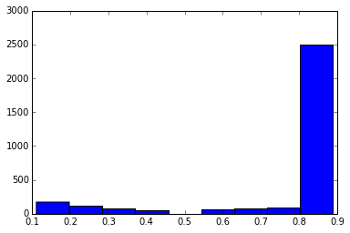
Results - Voting Matrix
Non-Unanimous Votes = 1.3% of Total
This Means a Single Estimator Could Possibly be Used
Simplifies and Speeds Analysis
Primarily 8 Votes non-entrepreneur, 1 vote entrepreneur

Slide 11

Next Steps
Analysis Limited by Computational Power
SVM
Enterprise
Distributed Computing
Find How Many Estimators is Optimal
Time
Entrepreneur Recall
See if a Single Estimator Could be Used Efficiently

Slide 12
Questions?

